Slide 1
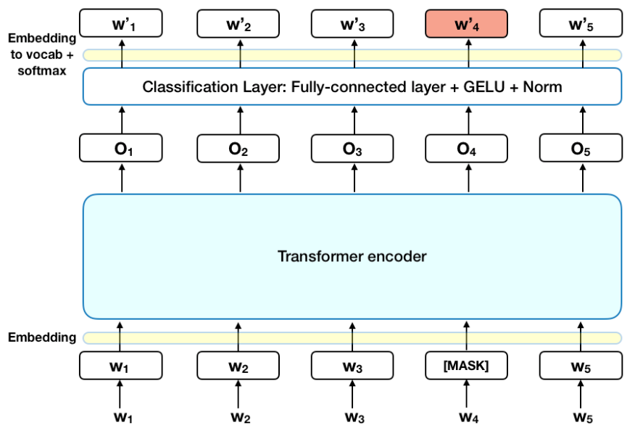
CS 747 Deep Learning - Final Project Proposal
Title: Multilingual Hate Speech Detection Using Modified Implementation of BERT
Team: Pratish Mashankar (G01354094) & Sreeja Puthumana (G01360679)
Reference Paper: BERT: Pre-training of Deep Bidirectional Transformers for Language Understanding.
Workflow:
MLMA Hate Speech Dataset
Handling class imbalance
Evaluation using Accuracy & F1
Benchmark Ghosh et al.
Robustness Test
Enhanced BERT implementation with new layers, and regularization
Proposal: To develop an advanced multilingual hate speech detection model based on an enhanced reproduction of BERT while handling class imbalance and performing robustness check

Slide 2
Summarizing BERT
Proposed Changes
References
The paper proposed BERT, a powerful language model trained on a diverse dataset and tested on various NLP tasks to achieve state-of-the-art results. Primary tests were made on IMDB movie review sentiment classification.
Handle class imbalance in MLMA data
Reproduce BERT with modified architecture and observe the change in evaluation metrics
Perform zero-shot and fully trained evaluation for multilingual data
Perform Robustness test on noise induction
Compare with Benchmark
BERT: Jacob Devlin, Ming-Wei Chang, Kenton Lee, and Kristina Toutanova. 2019. BERT: Pre-training of Deep Bidirectional Transformers for Language Understanding. In Proceedings of the 2019 Conference of the North American Chapter of the Association for Computational Linguistics: Human Language Technologies, Volume 1 (Long and Short Papers), pages 4171–4186, Minneapolis, Minnesota. Association for Computational Linguistics.
Dataset: Nedjma Ousidhoum, Zizheng Lin, Hongming Zhang, Yangqiu Song, and Dit-Yan Yeung. 2019. Multilingual and Multi-Aspect Hate Speech Analysis. In Proceedings of the 2019 Conference on Empirical Methods in Natural Language Processing and the 9th International Joint Conference on Natural Language Processing (EMNLP-IJCNLP), pages 4675–4684, Hong Kong, China. Association for Computational Linguistics.
Benchmark: Koyel Ghosh and Dr. Apurbalal Senapati. 2022. Hate speech detection: a comparison of mono and multilingual transformer model with cross-language evaluation. In Proceedings of the 36th Pacific Asia Conference on Language, Information and Computation, pages 853–865, Manila, Philippines. Association for Computational Linguistics.

